Slide 1
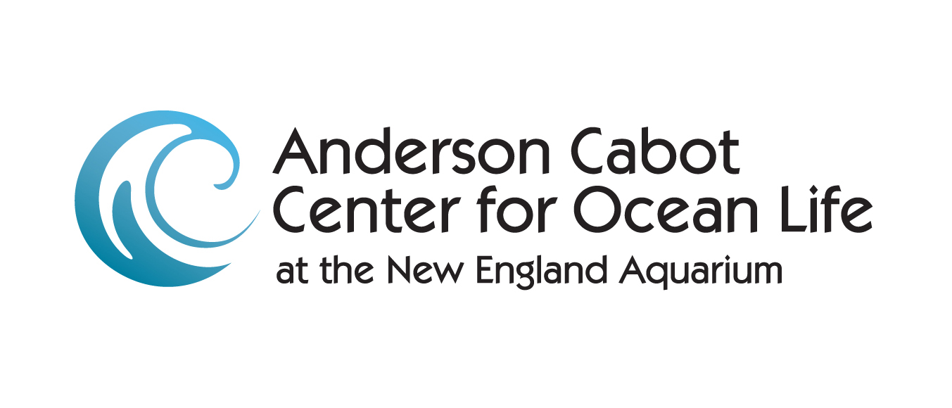


Techniques for Reducing Large Whale Entanglements
Tim Werner
March 29, 2017

Slide 2
Acknowledgments
Project PIs
Whale-Release Rope: NEAq (Amy Knowlton, Scott Kraus, MA LA, SSLFA)
Submerged Endline Project: WHOI (Keenan Ball, Jim Partan)
Fishing Industry Collaborators
Lori Caron, Beth Casoni, Dave Casoni, Denny Colbert, John Havilland, Patrice McCarron, Mike Lane, Rob Martin, Steve Keane, Kristan Porter, Sott Wesley, Elliot Thomas, Pat White
Engineers
Ken Baldwin, Ben Brickett, Jud DeCew, John Flory, Laurens Howle, Alan Lesser, Hank McKenna
Rope Manufacturers
Sean Burke, Donnie MacLean, Chris Berg, Jack Pace, Larry Powers. Chuck Gilchrest, Neil Prescott. Ryan Anacko
Whale Researchers
Michael Moore, Doug Nowacek
Bycactch Consortium Members
Blue Water Fishermen’s Association, Duke University, Maine Lobstermen’s Association, New England Aquarium, University of New Hampshire
Donors
NOAA/National Marine Fisheries Service; Commonwealth of Massachusetts Office of Energy and Environmental Affairs; US Marine Mammal Commission; WHOI; NEAq, incuding foundation grants from the Island Foundation and the Volgenau Foundation
CONTACT: Tim Werner (twerner@neaq.org)
WEBSITE: www.bycatch.org

Slide 3
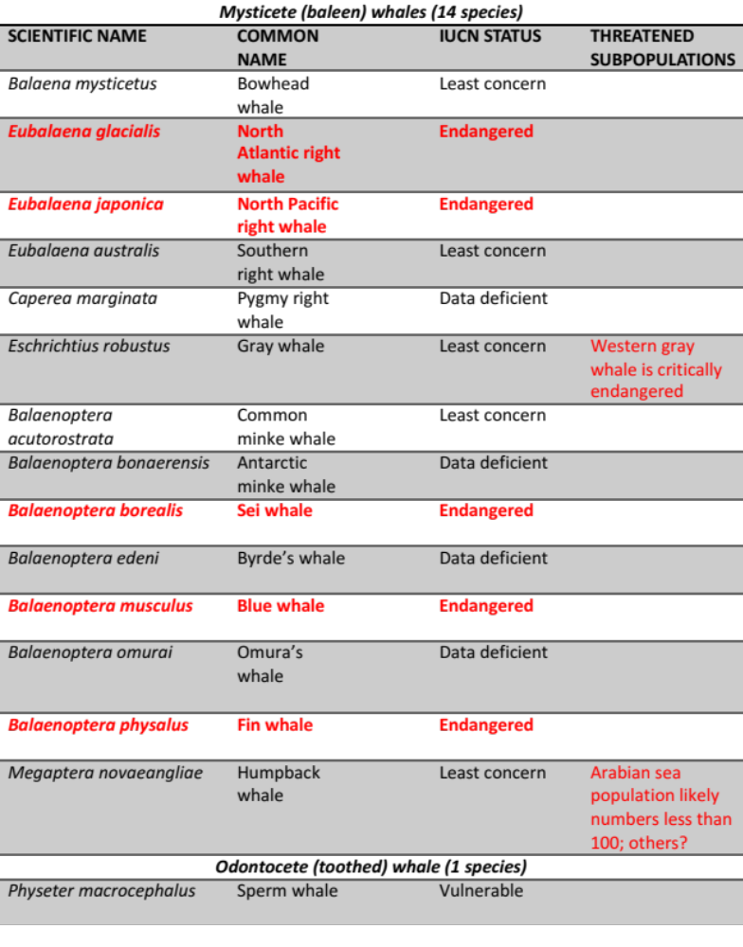
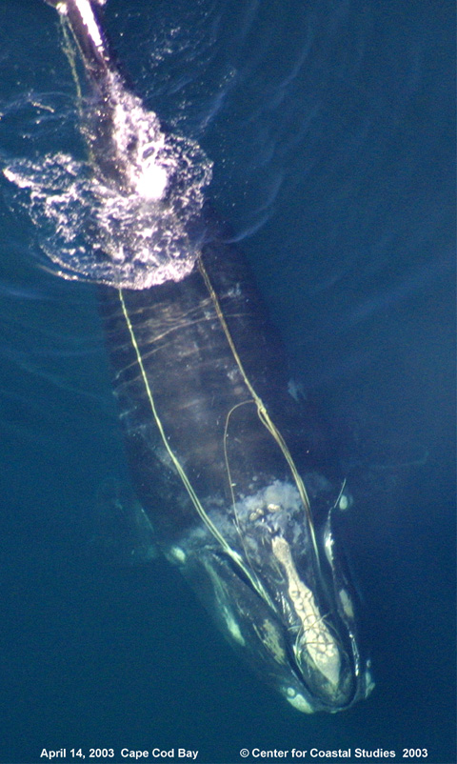
Entanglements involve all
15 species of ”great whales”
Werner et al., in prep.

Slide 4
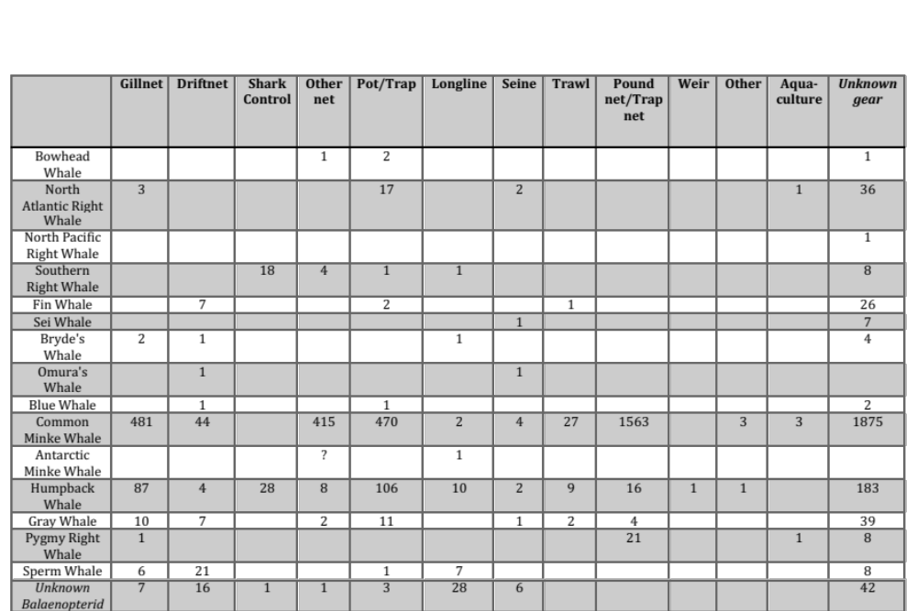
Profile of Entanglements (1990-2015)

Slide 5
Frequently reported from the NW Atlantic, S and E Atlantic, C and E Pacific, Indian Ocean, and W Pacific (IWC, 2010; 2011; Minton, 2015)
A GLOBAL PHENOMENON
Most entanglements go undetected—globally, regionally, and locally!

Slide 6
Strategies for Reducing the Incidence and/or Severity of Entanglements
Fish Less
  Time-Area Closures
  Effort Reduction (or cessation)
Fish Better (Modify gear or practices)
  Reduce Probability of Encounter
  Reduce Probability of Entanglement
  Post-entanglement Release Mechanisms
Switch Gear Type
Post-entanglement mitigation

Slide 7
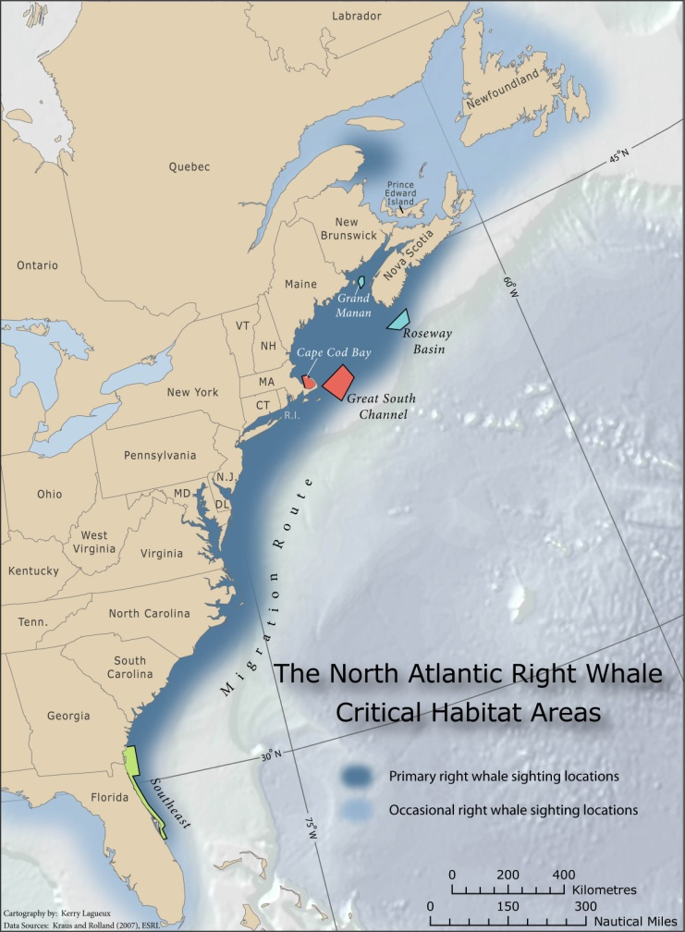
Fish Less: Time-Area Closures
Restrict fishing within all or a subset of a particular fishing zone, permanently or for a set time period (FAO 2011)
Some areas open but only with gear restrictions (may be time-area-gear closures)
Range from permanent ”no take” areas to consequence closures and dynamic area management

Slide 8
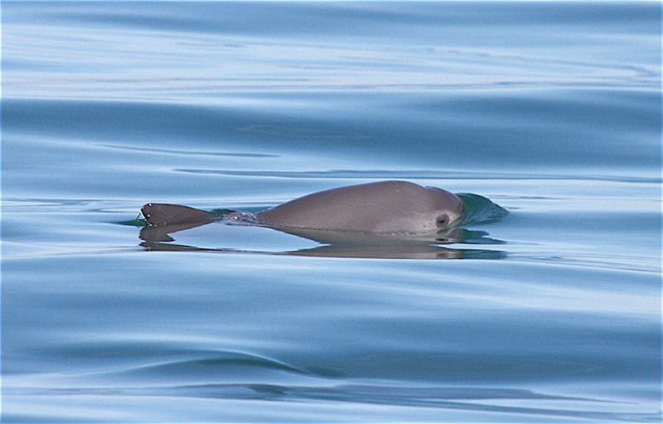
T. Jefferson

Slide 9
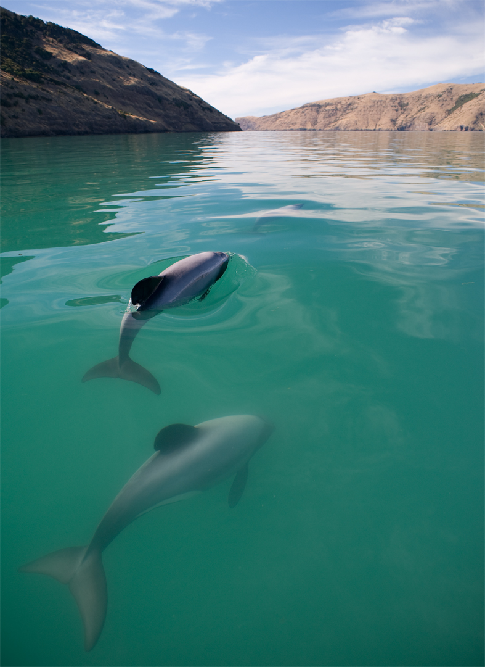
Fish Less: Time-Area Closures
Hector’s dolphin in New Zealand
Gormley et al (2012): increase in survivability within the reserve but insufficient to recover the overall population
Slooten et al (2013): National area management network insufficient for population recovery

Slide 10
Fish Less: Time-Area Closures
SUMMARY
Can protect individual animals within closure boundaries
To conserve or recover a species or population, however they need to be large enough, located in the right areas, effectively managed, and avoid introducing new threats (Gormley et al 2012; Slooten 2013)
T-A-Cs generally unpopular with fishermen

Slide 11
Fish Less: Effort Reduction
Examples:
Buy-outs
Reduction in licenses, permits

Slide 12
Fish Better
Reduce Probability of Encounter
Minimize ratio of vertical lines to units of gear deployed
Sinking or neutrally buoyant groundline
Submerged endlines
Grappling
Rope-less fishing
Reducing rope or net length
Visual enhancements
Sound-emitting devices
Fleet communication
Reduce Probability of Entanglement
Materially stiffening rope
High tension rope
Reducing the use of knots in ropes
Whale free buoy
Slippery rope
Post-entanglement release mechanisms
Decreasing gillnet mesh size
Gear tending (some offshore gillnetters).

Slide 13
Lobster/crab pot gear – NE US

Slide 14
Minimize ratio of vertical lines to units of gear deployed
What is it? Reducing the overall number of vertical lines used in a pot or gillnet gear fishery without reducing bottom gear. (“Trawling up”)
Evaluated? No. Assumption: fewer vertical lines, lower entanglement risk.
Observations:
  Heavier gear results in heavier ropes
  In GofME, if string =/> 5 traps, need to add a second endline
  More lost/damaged gear? (Rationale for singles in certain habitats)

Slide 15
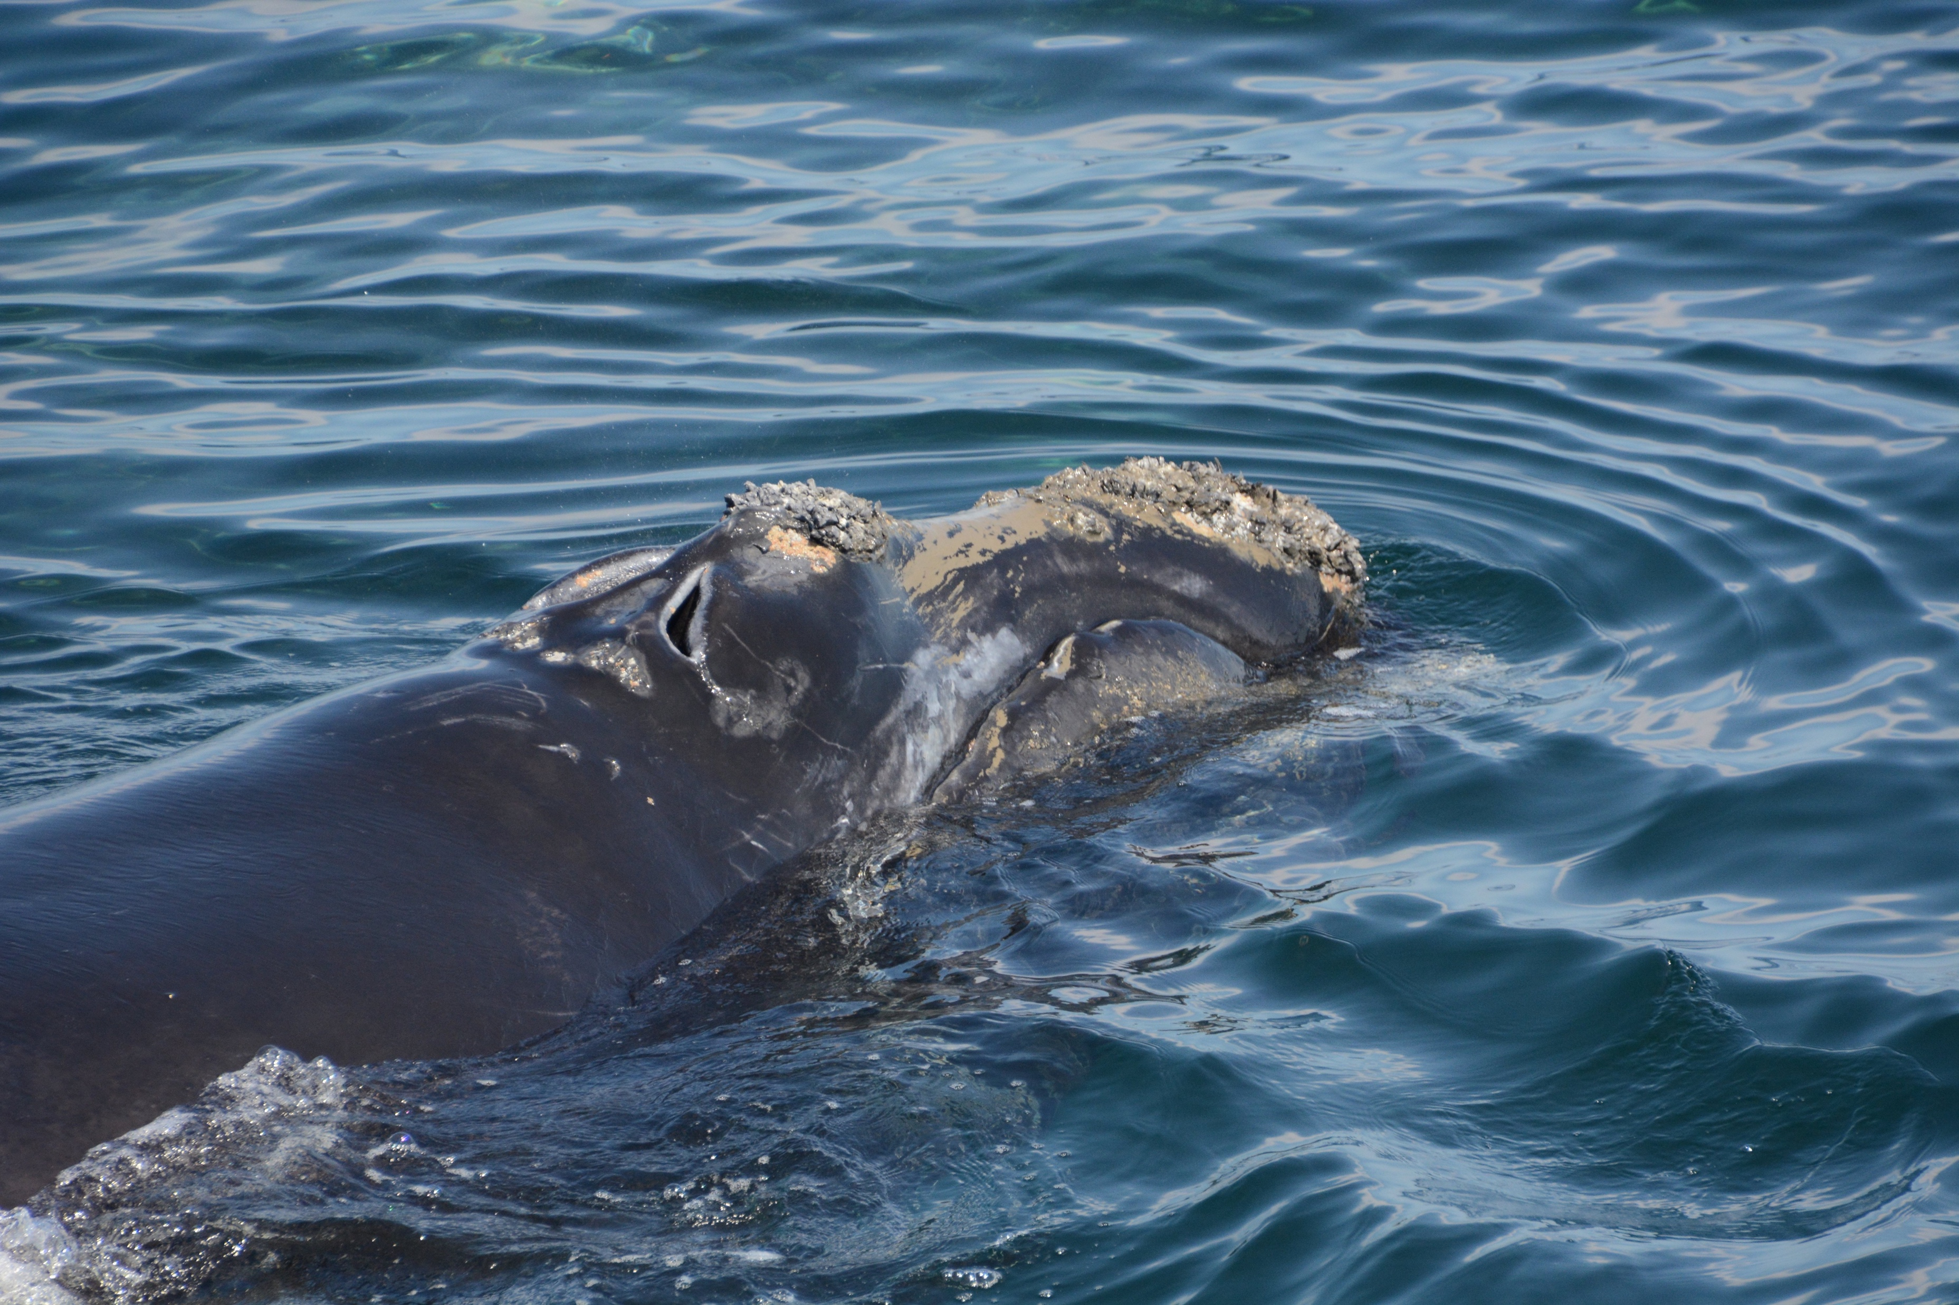
Sinking groundline
What is it? Having the line that connects traps to one another be negatively buoyant so that it lays on or near the seafloor versus up in the water column.
Evaluated? No. Assumption: Out of water column, no entanglement risk.
Observations:
  Probably reduces risk
  But bottom feeding?
  Ropes degrade quicker
  Reportedly more dangerous
  Harder to grapple?
  More lost gear?

Slide 16
“Rope-less” fishing
What is it? Pot fishing without using ropes or retention of buoy lines at or near gear on the sea-floor except during setting and hauling.
Evaluated? Yes. Used in SE Australia.
Observations:
  Adds significant operating cost
  Need to address absence of surface gear marking
  Only technique that completely eliminates entanglement risk from vertical lines
  Gear can be released acoustically or by using a timer

Slide 17
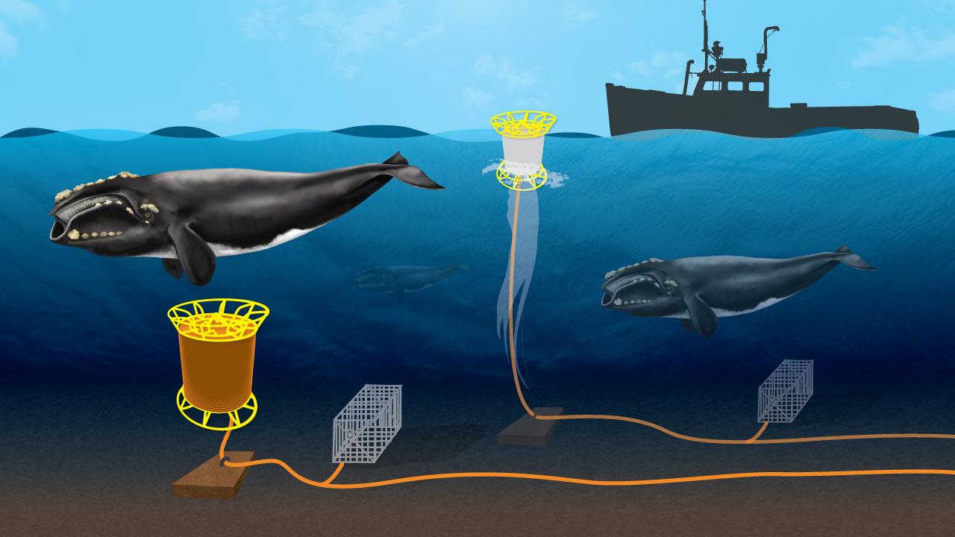
Submerged Buoyline Concept
WHOI

Slide 19
Reducing rope or net length
What is it? Using the minimal length of rope or gillnets (individual and net total) so as to reduce the overall amount of gear in the water column for reducing the probability of entanglements; includes avoiding wet storage.
Evaluated? No.
Observations:
  In general, using minimal gear a good thing
  Eliminating wet storage reduces soak time
  Unintended consequences: stiffer rope leading to more severe injuries?

Slide 20
Grappling
What is it? For strings of two or more fishing pots connected to one another by groundline, the use of grappling instead of vertical lines for retrieving gear to the surface.
Evaluated? Operationally, yes.
Observations:
  Technique already exists
  Increases haul time
  Same challenge of having gear invisible at surface

Slide 21
Sound-emitting devices
What is it? Sound-producing devices that generate a behavioral avoidance response in cetaceans (Deterrent, alarm, or alert)—e.g., pingers
Evaluated? Yes, with some species, including Humpbacks, but rarely with fishing gear
Observations:
  Behavioral responses in some species observed
  Acoustic signal propagation dependent on sound source power and frequency, directionality, pulse intervals, and habitat characteristics
  When behavioral response elicited, may be an option for areas with low gear density and other considerations
  Habitat ensonification, noise masking, habituation, more entanglements possible with high gear density or pinger malfunctions
  Fewer humpbacks caught in cod traps with “clangers” (Lien 1992)
  Noise from detonations created impaired hearing of humpbacks leading to more entrapment? (Todd 1996)
  No observed area avoidance in grey whales (Lagerquist et al 2012) but low sample size

Slide 22
Sound-emitting devices
3 studies with 3kHz pinger and humpbacks = NO RESPONSE
Harcourt et al 2014, How et al (2015), Pirotta et al (2016)

Slide 23
Mysticete (Baleen) Whales
Rod monochromats; essentially color blind
Adapted for seeing in low light conditions

Slide 24
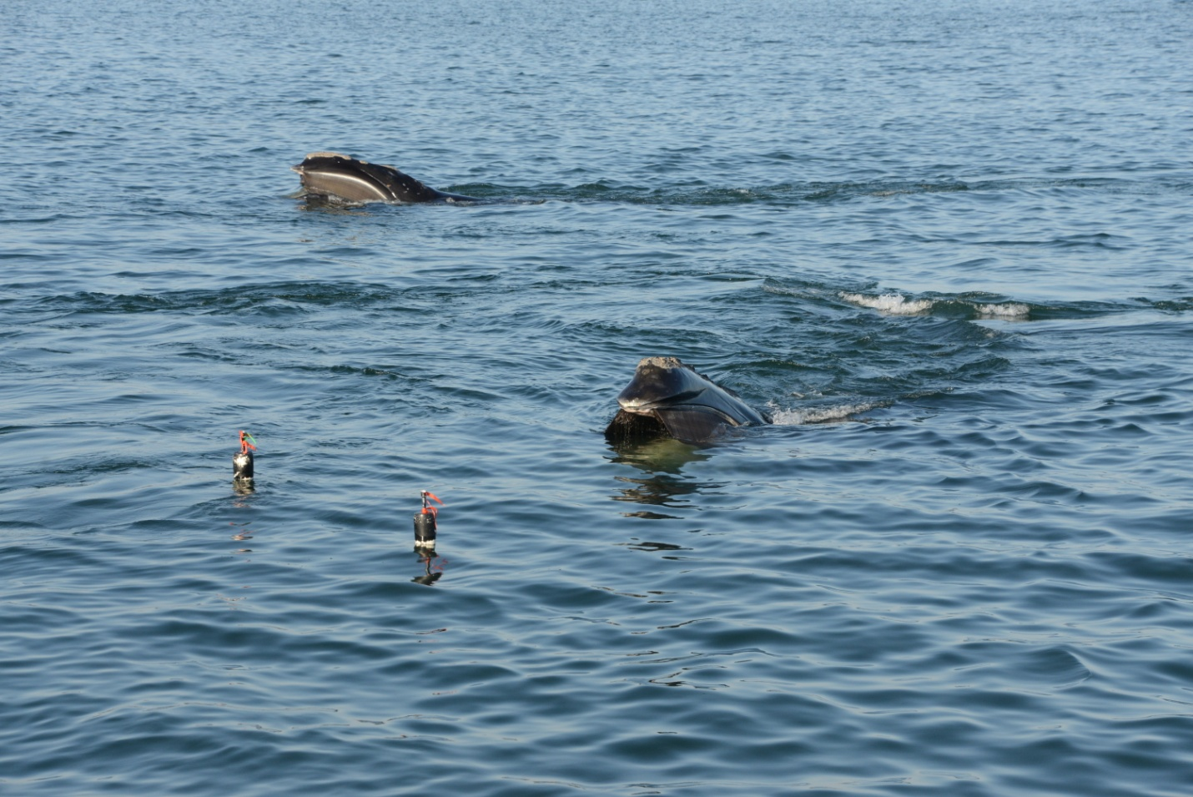
Kraus et al (2014) tested behavioral response of NARWs to rope mimics
Whales were able to detect red and orange “rope” from farther away (averages 3.85 and 4.1 m) than green ”rope” (1.9 m average)

Slide 25
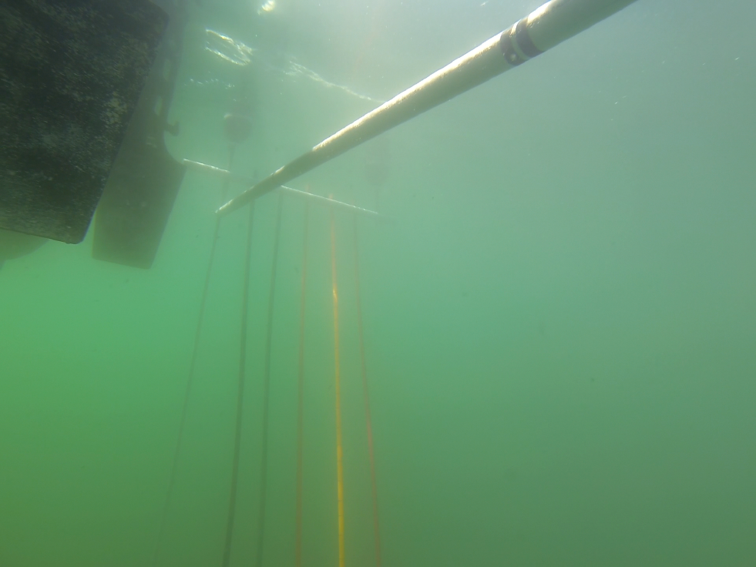


Slide 26
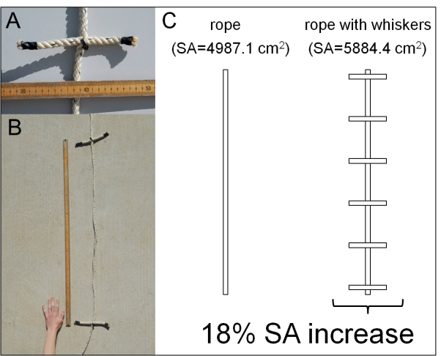
Kot et al, in submission

Slide 27
Fleet communication

Slide 28
Reduce Probability of Entanglement: Materially stiffened rope
What is it? Increased bending resistance of a rope, also referred to as rope “hardness” or “firmness.”
Evaluated? No.
Observations:
  Whales entangled in harder lay ropes (US west coast, W. Australia)
  Harder to splice so tend to be knotted – baleen entanglement issue

Slide 29
High tension rope
What is it? Increasing rope tension using the counter forces of surface flotation and bottom weight to create a taut line.
Evaluated? In modeled simulations.
Observations:
  Maintaining tension likely infeasible (and more dangerous?)
  Likely increases injury severity

Slide 30
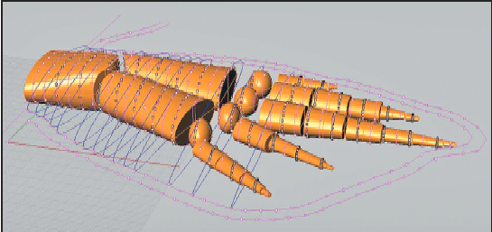
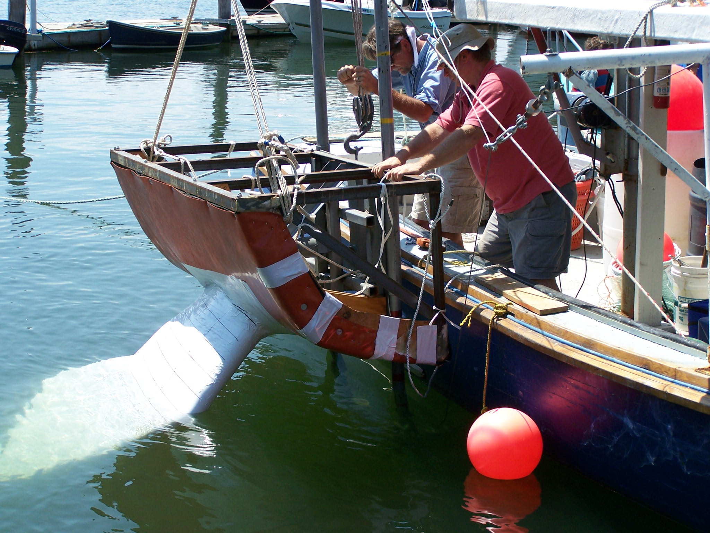
High tension rope
Ropes of higher tension may be more likely to cause lacerations than slacker ropes
Baldwin et al. 2012 (see: www.bycatch.org)
See also: Winn et al (2008)

Slide 31
Reducing use of knots
What is it? When connecting two pieces of rope, avoiding the use of knots in favor of more uniform attachments such as splices.
Evaluated? No.
Observations:
  Knots reduce breaking strength
  Presumably more likely to have rope become lodged in baleen

Slide 32
“Whale-free buoy”
What is it? A buoy with a flexible, tapered stem made of urethane or some other plastic (Goudey 2004).
Evaluated? No.
Observations:
  Could reduce probability of flipper entanglement
  Probably would increase mouth entanglements
C. Goudey, MIT

Slide 33
Slippery rope
What is it? A rope developed to be more slippery of have less friction so that a whale might shed gear more easily.
Evaluated? No.
Observations:
  Many engineering and fishing challenges likely insurmountable

Slide 34
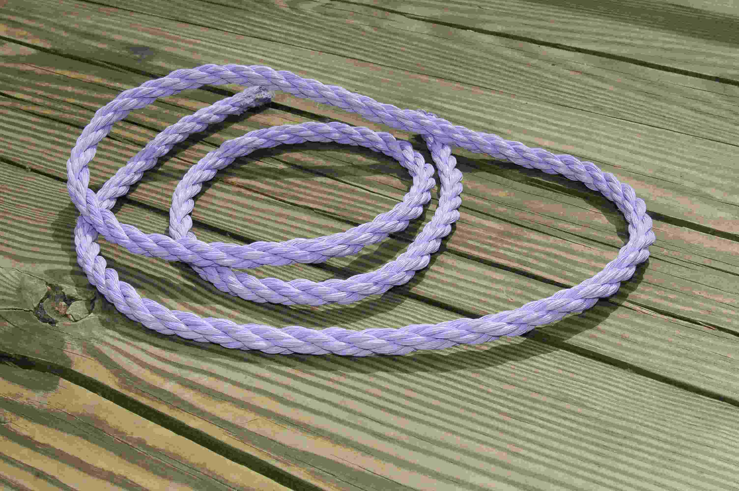
Post-entanglement release mechanisms
What is it? Several devices currently used or proposed for weakening portions of pot and gillnet gear, and also line cutting devices, to help passively free a whale after it has become entangled.
Evaluated? Some, yes.
Examples:
Weak links
Timed line cutters
Galvanic releases
Reduced breaking strength ropes
Etc.

Slide 36
Rope diameter in actual entanglements
Knowlton et al, 2016

Slide 38
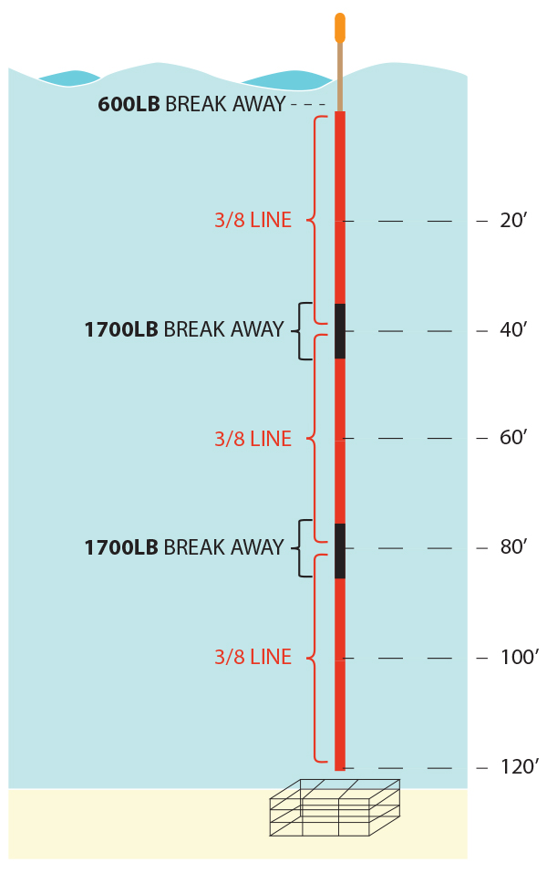
Whale-release rope prototypes
J. Haviland

Slide 39
Evaluation of whale-release rope (2017)
Lab testing of prototypes
Field testing with fishermen
Modeling gear loads
Simulating entanglements using a computer generated whale model

Slide 40
Rope load modeling using Orcaflex software

Slide 41
Switch gear type
EXAMPLES:
Gillnets to pots (North Sea)
Gillnets to handlines (Argentina)
Longlines to pots (Alaska sablefish fishery)

Slide 42
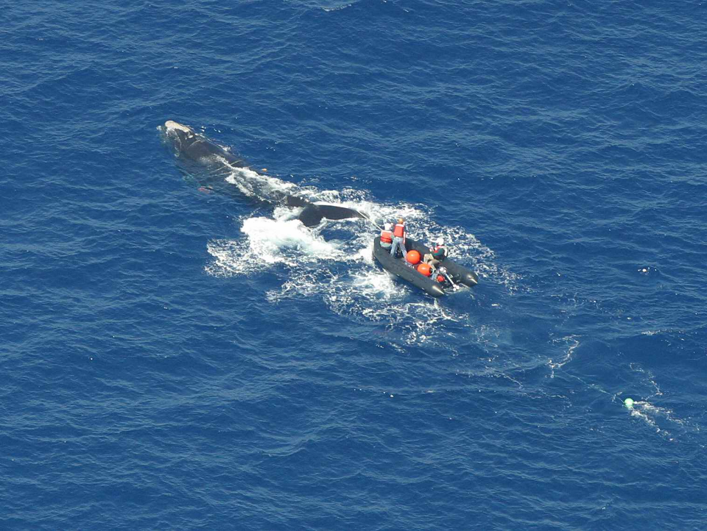
Post-entanglement mitigation (intervention)
Katharine Jackson/Florida Fish and Wildlife Conservation Commission

Slide 44
Summary
Fishing less – not popular with fishermen; T-A-Cs likely need to be impractically large in total extent to be effective. (Not a stand-alone strategy)
Switching gear – for pot gear no precedence, and not so appropriate for crustaceans
Post-entanglement intervention – Important for animal welfare, can teach us about entanglement reduction methods, but not a solution at least for small populations, and detracts from focusing on preventing entanglements in the first place

Slide 45
Summary
Fishing better
Avoid assumptions about high tension ropes
Look out for trade-offs
Consider what evidence exists to support modifying gear or practices before making regulatory and expensive changes that are hard to undo
Study and profile range of gear used
Draw from expertise among fishermen, engineers, and scientists working in constructive collaborations
Mark different parts of gear and deployment areas so that we know which ones were likely involved in the entanglement

Slide 46
Summary
Mods techniques only rarely evaluated
Difficulties in testing: Size of animals, relative rarity of entanglement events (sample size), need to avoid needlessly endangering whales
Identify situations in which tests can be carried out, and use novel approaches (such as studying gear involved in entanglements and computer modeling)
Almost certainly need multiple strategies working in concert

Slide 47
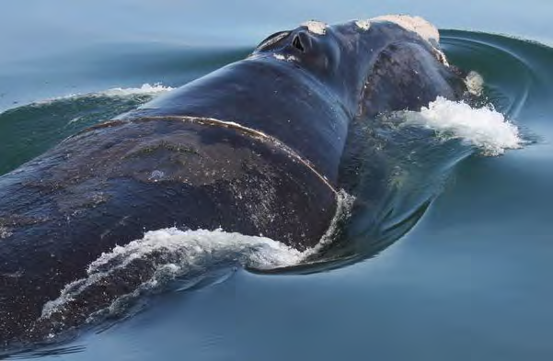
Summary
18 Dec 200 GDNR
Use whale-release rope (short-term, lighter duty gear at least) that is visually enhanced, and for the future identify “rope-less” technologies, at least for offshore, heavier duty gear

